Slide 1
Topic: Compound Interest
EQ: How do I calculate the final amount if compounded daily?

Slide 2
Compound Interest
Simple interest – interest is paid only on the principal
Compound interest – interest is paid on both principal and interest, compounded at regular intervals

Slide 3
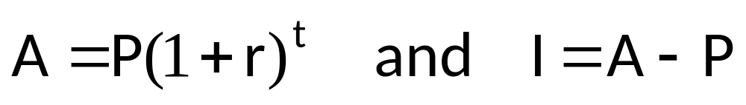
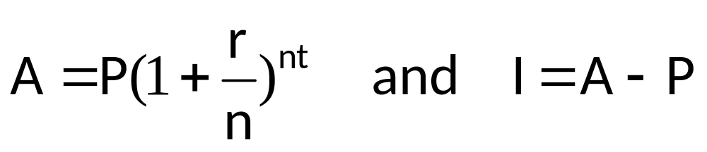
Compound interest formula
Compounded Annually:
Compounded n times a year:
A = the compound amount or future value
P = principal
r = interest rate per period of compounding
t = time
n = number of periods
I = interest earned

Slide 4


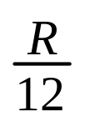
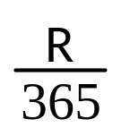
Period | Interest Credited | Times Credited per year | Rate per compounding period
Annual | year | 1 | R
Semi-annual | 6 months | 2
Quarterly | quarter | 4
Monthly | month | 12
Daily | Day | 365

Slide 5
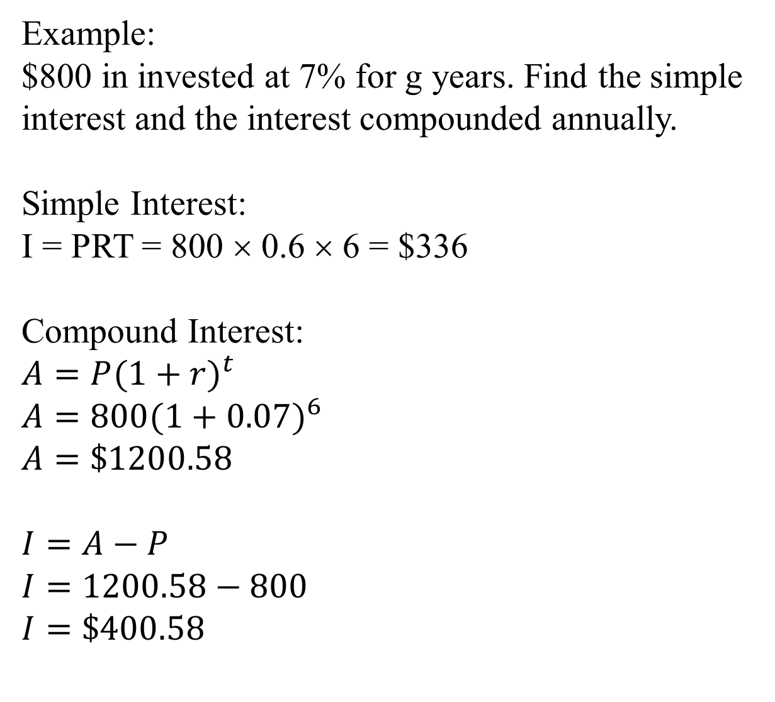

Slide 6
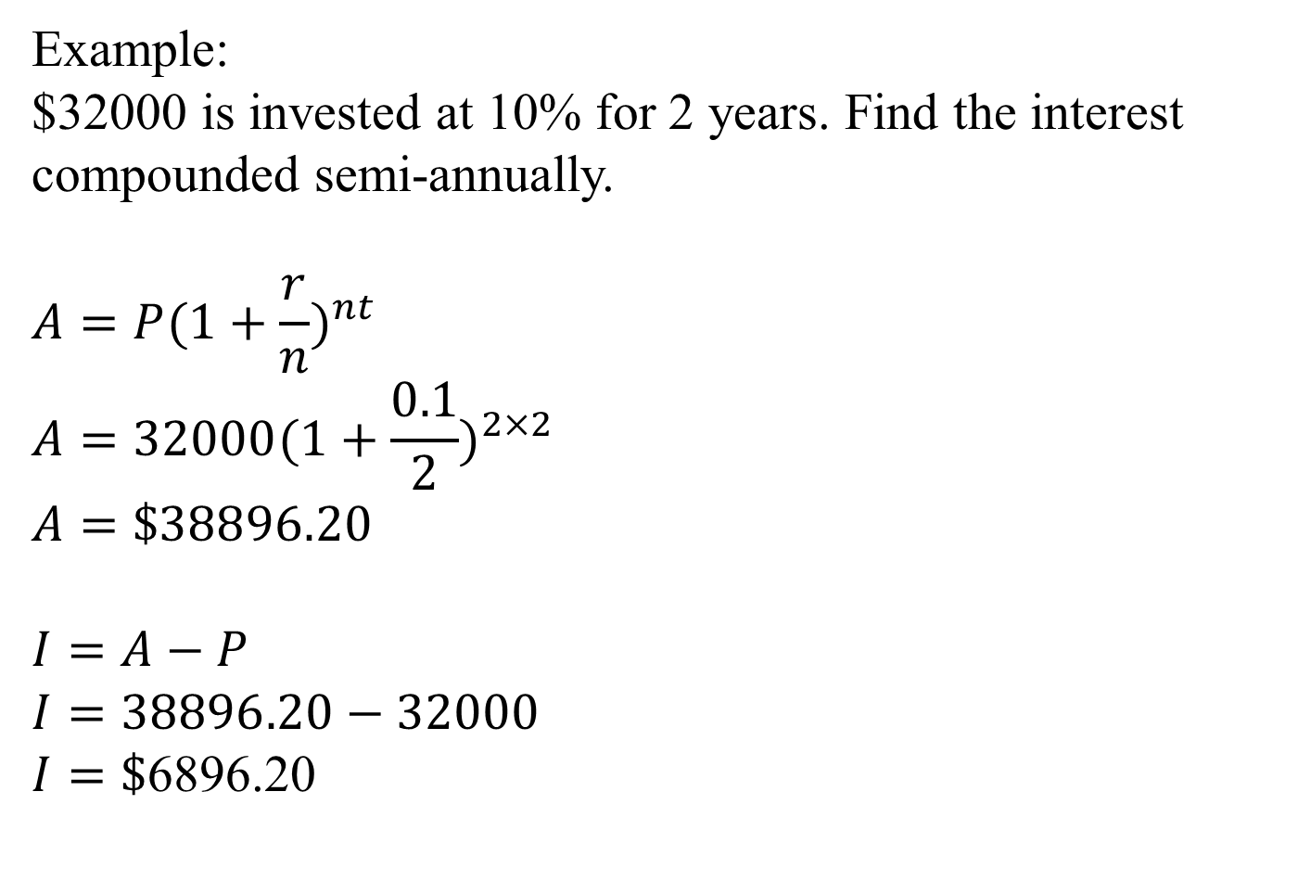

Slide 7
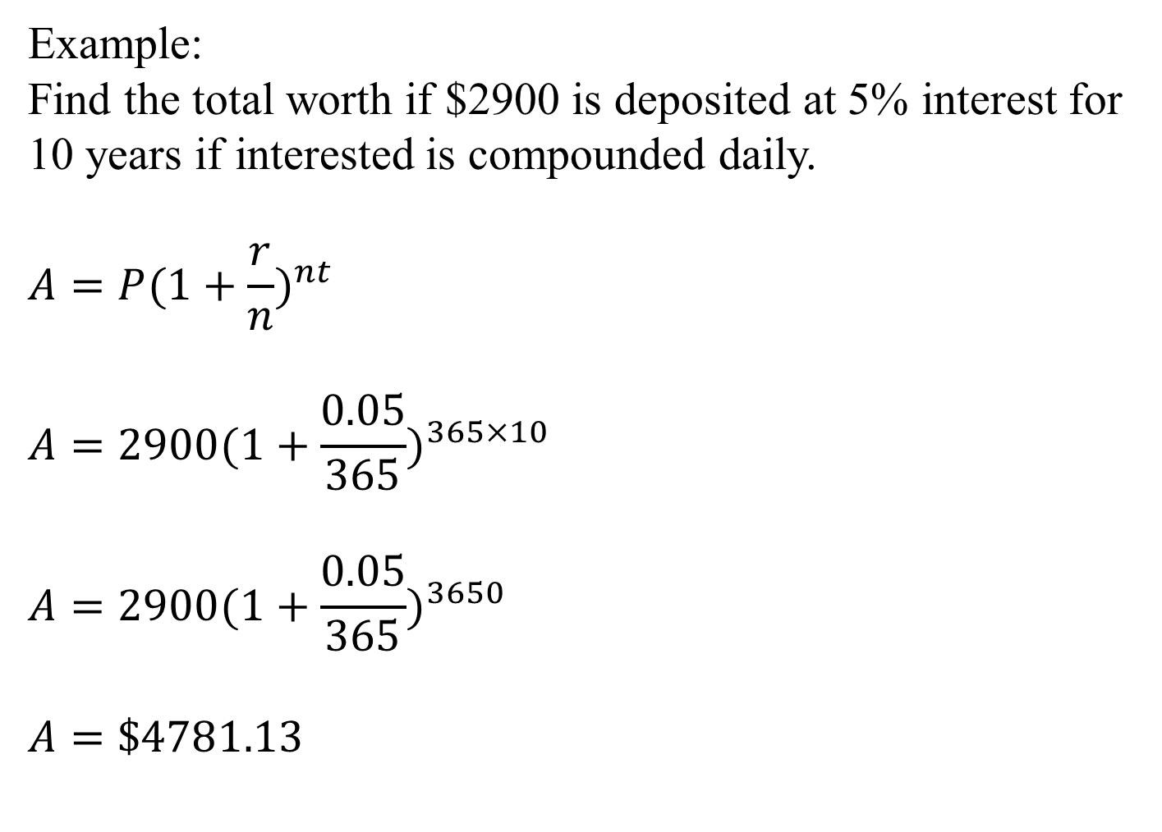

Slide 8
READ: Pages 51-55
DO: Exercise 4A, Pages 55-56

